Slide 1
LANDIS-II Quick Introduction Updated 2018
Professor Robert Scheller
North Carolina State University

Slide 2
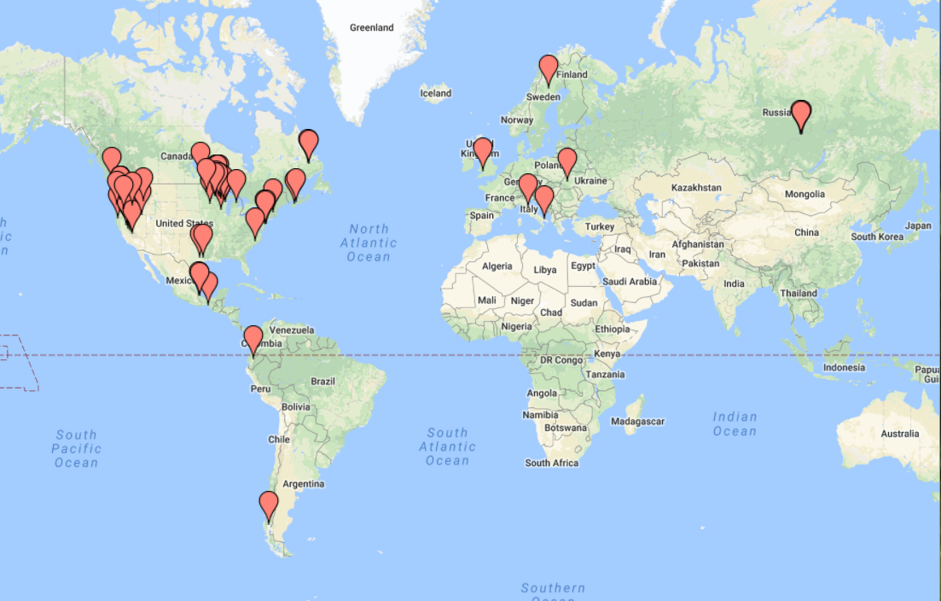
LANDIS-II Applications

Slide 3
General Features

Slide 4
LANDIS-II
LANDscape DIsturbance and Succession
II: Second Generation
Begun in the mid-1990s
LANDIS-II released in 2005
V6 released in 2012
Notes:
Add citation

Slide 5
LANDIS-II
Simulates succession
Succession
an emergent property of species life-history attributes, disturbance, and dispersal
no single pathway
responds dynamically to climate change, introduced species, novel disturbance regimes, etc.

Slide 6
LANDIS-II
Simulates forest landscape disturbance
Disturbance
includes fire (x2), wind, harvesting (x2), insects (x2), fuels management (x2)
disturbance events are stochastic and dependent upon probabilities
modeled as agents or objects acting on the landscape

Slide 7
LANDIS-II General Features
Optimized for ‘Landscapes’
typically 10,000 – 10,000,000 ha
efficiently manages >10⁶ interacting cells
core assumptions reflect these expected scales
Spatial and Temporal Flexibility
variable time steps for each process
variable spatial resolution and extent
Built for Collaboration
on-line database of extensions
Fully open-source
flexible model architecture

Slide 8
LANDIS-II
FORESTED LANDSCAPE
DISPERSAL
TREE / SHRUB
ESTABLISHMENT
INSECTS / DISEASE
HARVESTING
GROWTH
FIRE
MORTALITY
WINDTHROW
SPATIALLY INTERACTIVE
PROCESSES
NON-SPATIAL COMMUNITY
PROCESSES

Slide 9
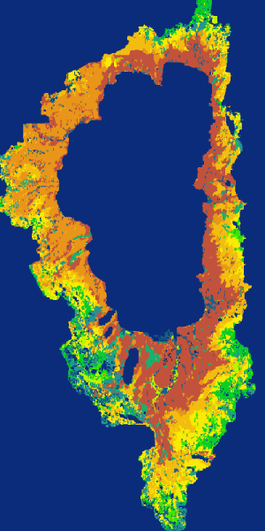
LANDIS-II
Climate Change
Roots & Soil (C, N)
Seed
Dispersal
Fire
Insects
Harvest or
Thinning
http://www.landis-ii.org/

Slide 10
LANDIS-II Philosophy
What makes LANDIS-II unique?
Driven by Life History Attributes
Spatially Dynamic
Simplification Through Homogeneity
User Determined Complexity
Fast Evolution

Slide 11
LANDIS-II Philosophy: Life History Attributes
LANDIS was founded on the principle of life history attributes (Noble and Slatyer 1980).
Life history attributes are the unique life history characteristics of each species or functional group. Species are the norm; functional groups used less frequently.
Life history attributes define how a species or functional group will respond to disturbance and competition.

Slide 12
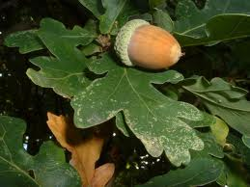
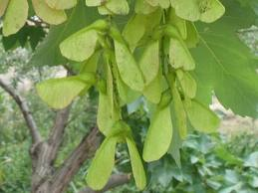
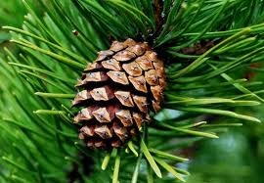
LANDIS-II Philosophy: Life History Attributes
Examples include: shade tolerance, longevity, fire tolerance, seed production age, seed dispersal distances, etc.
Life history attributes can optionally include chemical and physiological properties.

Slide 13
LANDIS-II Philosophy: Life History Attributes
Question: How to represent trees and shrubs?
Problem: At broad scales, we cannot represent individuals.
Solution: Aggregate individuals into SPECIES and AGE cohorts. [Species can be functional groups.]
Example:
Actual site 10 year species and age cohorts
Sugar maple ages: Sugar maple cohorts:
2,3,16,89,112 1-10, 11-20, 81-90, 111-120
Hemlock ages: Hemlock cohorts:
6,8,24,56,225 1-10, 21-30, 51-60, 221-230

Slide 14
LANDIS-II Philosophy: Life History Attributes
Species and Age Cohorts:
Cohorts are grouped by age
Cohort age ranges (or ‘bins’) are flexible
You can have multiple species at each site and multiple cohorts (ages) for each species or functional group.
An abstract cohort
An example cohort
Species
Acer rubrum
Age range
21-30 years old

Slide 15
LANDIS-II Philosophy: Life History Attributes
Species and Age Cohorts:
Cohorts can be extended to include quantitative data
Example: Cohorts with aboveground biomass.
An abstract cohort
An example cohort
Species
Acer rubrum
Age range
21-30 years old
Biomass
5 Mg ha⁻¹

Slide 16
LANDIS-II Philosophy: Life History Attributes
Is LANDIS-II limited to species and age cohorts?
No. We have attached many attributes to species-age cohorts, such as density, diameter, etc.
To date, aboveground biomass (total) and wood/leaf biomass have been added. Density coming soon!
ALL cohorts must be associated with a suite of life history attributes.

Slide 17
LANDIS-II Philosophy
What makes LANDIS-II unique?
Driven by Life History Attributes
Spatially Dynamic
Simplification Through Homogeneity
User Determined Complexity
Fast Evolution

Slide 18
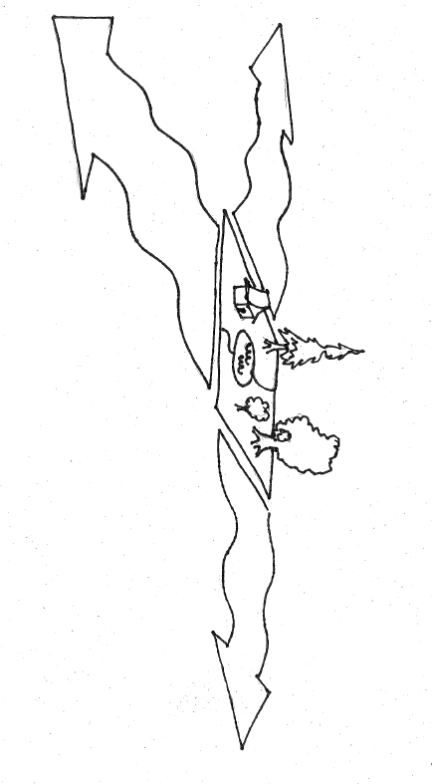
LANDIS-II Philosophy: Spatially Dynamic
Spatial Interactions
information
energy
Landscape context and configuration are critical
matter

Slide 19
LANDIS-II Philosophy: Spatially Dynamic
Disturbances and dispersal are spatially dynamic
Therefore, the code is optimized for spatially dependent and dynamic neighborhood interactions
F

Slide 20
LANDIS-II Philosophy: Spatially Dynamic
Neighborhood interactions can include:
adjacent neighbors (e.g., fire spread)
non-adjacent neighbors (e.g., seed dispersal)
neighborhood size and shape is dependent upon the process and parameters
F

Slide 21
LANDIS-II Philosophy: Spatially Dynamic
Cohort Biomass
Soil Carbon & Nitrogen
Insects
Fire
Disturbances overlap in space and time.
Wind
Harvest
Spatially Interactive
Landscape

Slide 22

LANDIS-II: Forest Landscape Simulator
Fire
Wind
Biomass
Cohort Biomass
Soil Carbon & Nitrogen
Insects
Fire
Wind
Harvest
Spatially Interactive
Landscape

Slide 23
LANDIS-II Philosophy
What makes LANDIS-II unique?
Driven by Life History Attributes
Spatially Dynamic
Simplification Through Homogeneity
User Determined Complexity
Fast Evolution

Slide 24
LANDIS-II Philosophy: Homogeneity
LANDIS assumes homogeneity at multiple scales:
Sites = single cells
Ecoregions = 1 or more cells, typically defined by climate and soils. Need not be contiguous.
Landscape
Sites
Ecoregions

Slide 25
LANDIS-II Philosophy: Homogeneity
LANDIS assumes homogeneity at multiple scales:
Sites are homogeneous in regards to light levels, other attributes
Ecoregions are homogeneous in regards to species establishment and ecosystem process rates
Landscape
Sites
Homogeneous light environment
Ecoregions
Homogeneous establishment and ecosystem process rates

Slide 26
LANDIS-II Philosophy: Homogeneity
LANDIS assumes homogeneity at multiple scales:
Disturbances can have their own unique aggregations of sites.
For example, fire regions are homogeneous in regard to fire size, ignition probability, etc.
Harvesting divides the landscape into both management areas and stands (two levels of aggregation).
Landscape
Sites
Homogeneous light environment
Fire Regions
Homogeneous fire regime

Slide 27
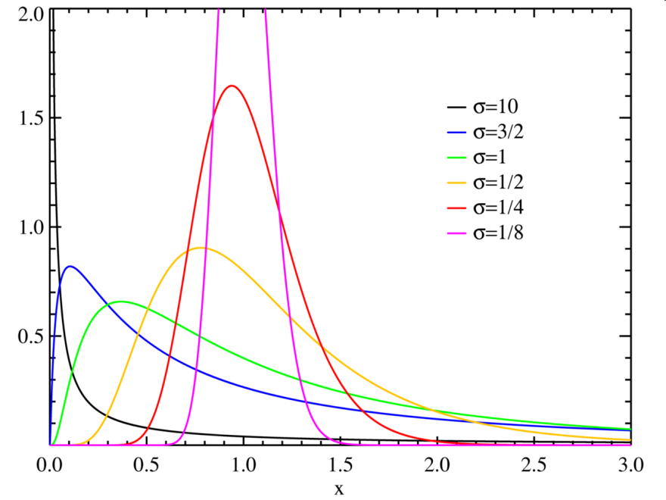
LANDIS-II Philosophy: Homogeneity
How do we define homogeneity?
Can be characterized by a single value or a distribution
Example: Fire Size ~ Log Normal(μ, σ)

Slide 28
LANDIS-II Philosophy
Homogeneous areas are NOT static
Sites have dynamic community composition, other site attributes change through time
Species establishment and ecosystem process rates can be temporally dynamic
Landscape
Sites
Dynamic community composition
Ecoregions
Establishment and ecosystem process rates can change through time

Slide 29
LANDIS-II Philosophy
Final Note:
Some new succession extensions dispense with the concept of ecoregions.
Instead, soils are highly variable, although climate continues to be ‘lumped’ into homogeneous units.
Landscape
Sites
Dynamic community composition
Climate Regions

Slide 30
LANDIS-II Philosophy
What makes LANDIS-II unique?
Driven by Life History Attributes
Spatially Dynamic
Simplification Through Homogeneity
User Determined Complexity
Fast Model Evolution

Slide 31
LANDIS-II Philosophy: User Determined Complexity
Every modeler’s job is to keep their model as simple as necessary, but no simpler
Our goal: Strategically enable additional complexity
always keep the older, simpler extensions

Slide 32
LANDIS-II Philosophy: User Determined Complexity
LANDIS-II has a Core and many extensions.
Extensions contain the ecological processes: succession and disturbances.
There can be many different extensions for each process: different questions = different extensions. Extensions have varying degrees of complexity.

Slide 33
LANDIS-II Extensions
Disturbance
Extensions
Succession
Extensions
Output
Extensions
A scenario has none or many
Generates maps and summary tables
A scenario has only one
Always includes aboveground dynamics
Can include below ground C/N dynamics
A scenario has one or many
Generates maps and/or tables

Slide 34

Succession Basics
Species Life History Attributes
Shade Tolerance
Fire Tolerance
Longevity
Seed Dispersal
Vegetative Reproduction
Serotiny
(Species / Age Cohorts)
Local
Ecoregion
Probability of Establishment

Slide 35
Disturbance Basics
Disturbances remove cohorts from sites
Partial cohort removal with biomass succession
Disturbance extensions
Define the spatial and temporal pattern
Identify which cohorts are affected
Examples:
Fire
Harvest
Wind
Insects

Slide 36
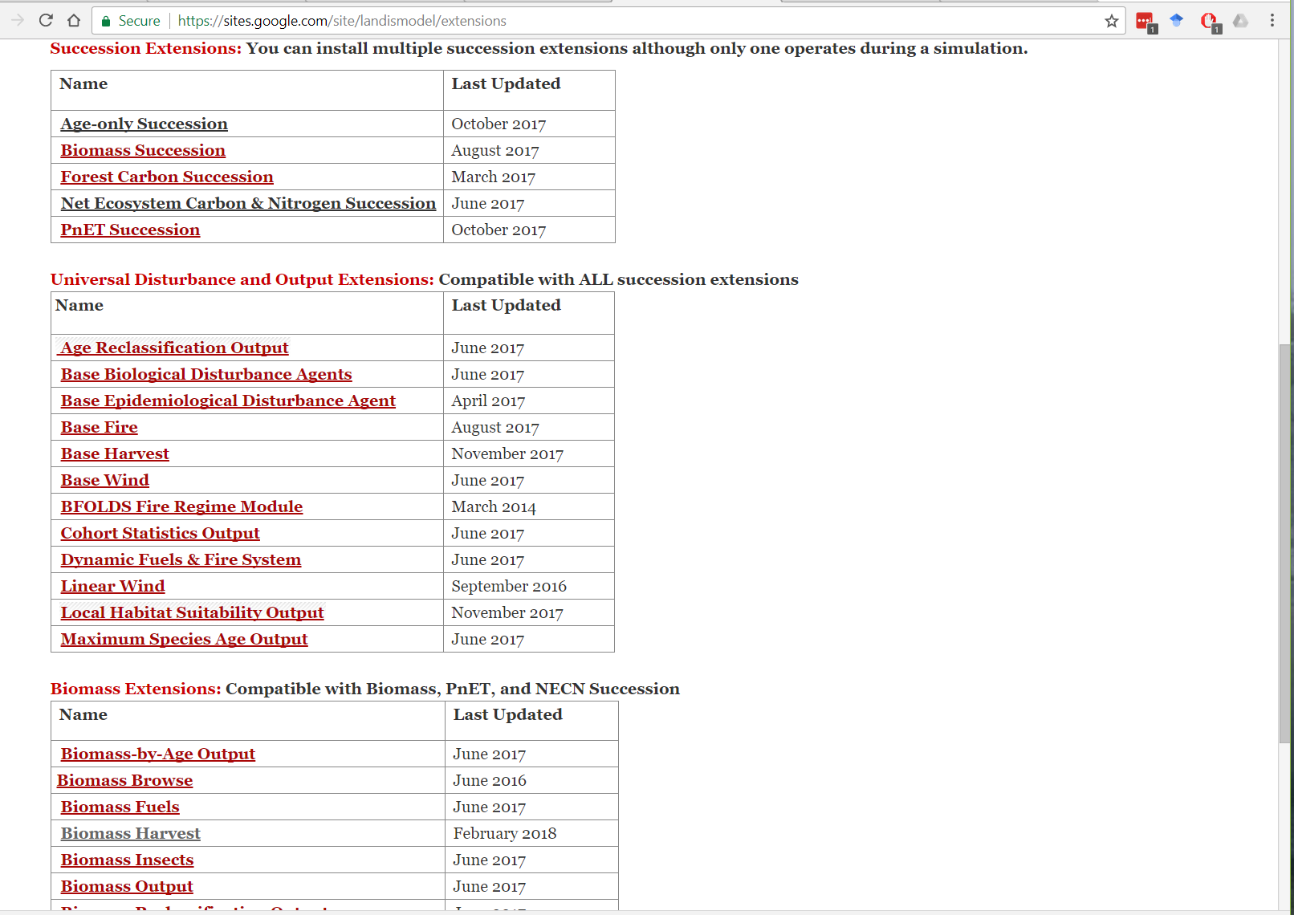
LANDIS-II Philosophy: User Determined Complexity
The user decides the level of the level of complexity necessary to address a question
The user downloads and activates only the extensions necessary for a given scenario

Slide 37

LANDIS-II Forest Landscape Simulator
Landscape Change Model
Wildfire
Dispersal
& Migration
Tree
Growth
Wind
Storms
Forest
Management
Pests
& Insects

Slide 38
LANDIS-II Philosophy
What makes LANDIS-II unique?
Driven by Life History Attributes
Spatially Dynamic
Simplification Through Homogeneity
User Determined Complexity
Fast Model Evolution

Slide 39
LANDIS-II Philosophy: Fast Evolution
All components are open-source and easily modified.
Scientists can download extension code and tweak or re-write as necessary
Visit our GitHub page! https://github.com/LANDIS-II-Foundation
C# language is a low barrier
our code is literate

Slide 40
LANDIS-II Core Implementation

Slide 41
LANDIS-II Core
LANDIS-II Core functions:
For this introduction, we will consider everything that is NOT an extension to be the Core.
Inputs and validates life history attribute data, ecoregion data, and scenarios
Handles landscape functions
active vs. inactive sites
reading and writing maps

Slide 42
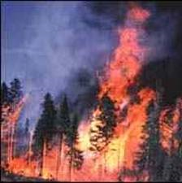
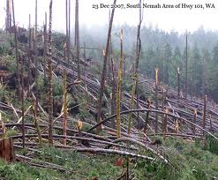
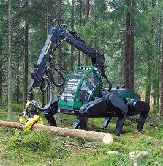
LANDIS-II Core
LANDIS-II Core functions:
Manages extensions
verifies they are the correct type
helps extensions share data
Executes extensions in their proper order
1
2
3

Slide 43
LANDIS-II Core
LANDIS-II Core functions:
The User interacts with the Core via the SCENARIO file.
In the scenario file, the user indicates:
which extensions are active
simulation duration
cell size
species, ecoregions, initial community file

Slide 44
LANDIS-II Core
Fire
Biomass Succession
Harvest
Core
Reclassify Output
Insects
Raw Output
Wind

Slide 45
LANDIS-II Core
Disturbance
Extensions
Succession
Extensions
Base Harvest
Base Wind
Base Insects
Base Fire
Dynamic Fire & Fuel
…
Base Age-only
Base Biomass
Nutrient-cycling
Century-soil
…
Core
Output
Extensions
Forest Age
Spp. Biomass
Reclassified Map
…

Slide 46
LANDIS-II Reproduction and Variable Time Steps

Slide 47
Reproduction
Reproduction happens at:
every succession time step across the landscape
After a disturbance at individual sites
What is the order of operation?
Planting
Serotiny
Vegetative reproduction
Seed dispersal

Slide 48
Reproduction
However, the cohorts must be ‘synchronized’ if disturbance and succession extension are operating at different time steps.
The following slides demonstrate our method for doing so.

Slide 49
Variable Time Steps
Each extension (‘plug-in’) operates at its own time step, from 1 - 100+ years.
Extension types:
succession
disturbance
output
Cohort age bins match the succession time step. For example: If succession = 20 yrs, then cohorts = 1 - 20, 21 - 40, 41 - 60 yrs and so on.

Slide 50
Variable Time Steps
Example:
Succession every 10 years
Fire every 3 years
Output every 5 years
The LANDIS-II Core operates at an annual time step.
Every year, the core checks whether each extension should run.
Disturbance extensions will typically only alter a sub-set of sites.
Reproduction will occur immediately following a disturbance event at a site.
The following slides illustrate these interactions at one site…

Slide 51
Variable Time Steps
Example: a single site
Succession (S) every 10 years
Fire (F) every 3 years
Output (O) every 5 years
New cohorts (C1) added to age class 1-10.
C1 aged into age class 11-20.
C2 (7 yrs old) are placed into age class 1-10 yr.
If a disturbance alters a site, reproduction occurs at that site (add C2).
time

Slide 52
Variable Time Steps
Example: a single site
Succession (S) every 10 years
Fire (F) every 3 years
Output (O) every 5 years
C1 aged into age class 11-20.
C2 (7 yrs old) and C3 (4 yrs old) are combined into age class 1-10 yr.
New cohorts (C1) added to age class 1-10.
time
Disturbance alters a site, reproduction occurs (add C2).
Disturbance @ year 6:
Incorporates presence of C2.
Reproduction occurs (add C3).

